Slide 1
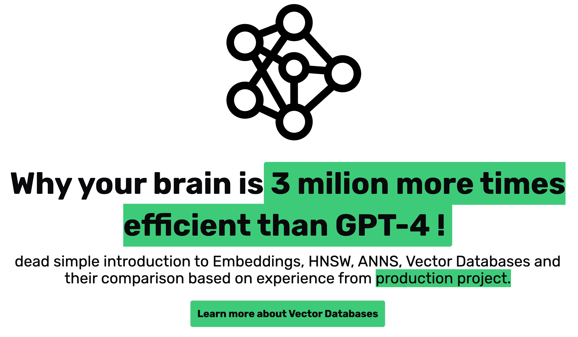
Olaf Górski

Slide 2
Intro
How it all came to be
Recently I had to go on journey into the Vector Database world and pick one for a particular project. And oh boy, was it a ride. Recently Vector Databases have gained a newfound attraction and spotlight thanks to the rise of LLMs. Such situation is both a blessing and a little bit of a curse, bringing some of the things attributed to LLMs to Vector Databases too - the perception they are 'a new thing', untested technology or some shiny crap good only for LLM-based stuff. All of which is wrong.
In case of Vector Databases I was, and still am, actually, completely green. So I had to go around, gather facts, check stuff out and form my opinion regarding each particular database, as to select one for my particular use case.
Before we begin, let me put a disclaimer here. I do not title myself as an expert in AI. There are all my just personal ramblings, opinions, certainly biased. Take everything you read with a grain of salt and do your own due dilligence.

Slide 3
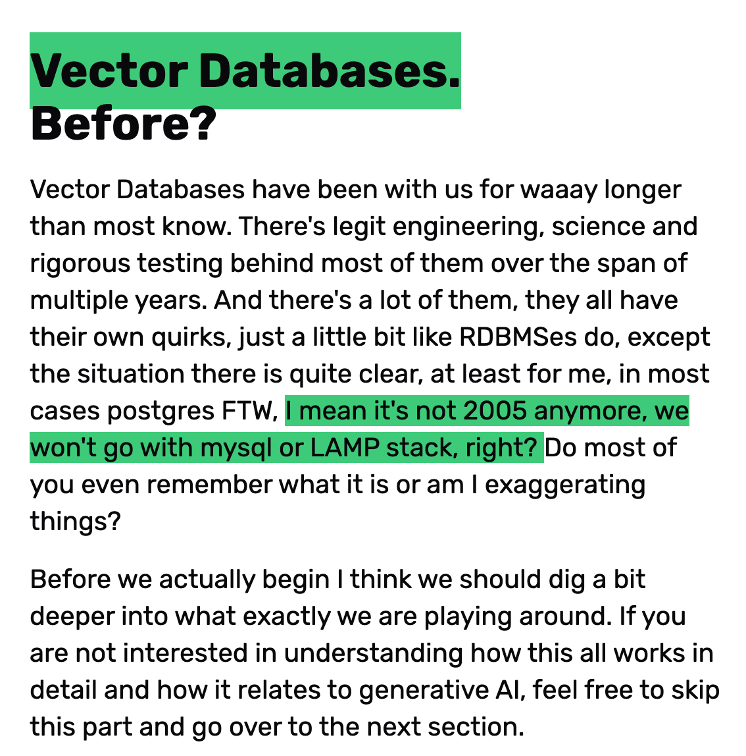
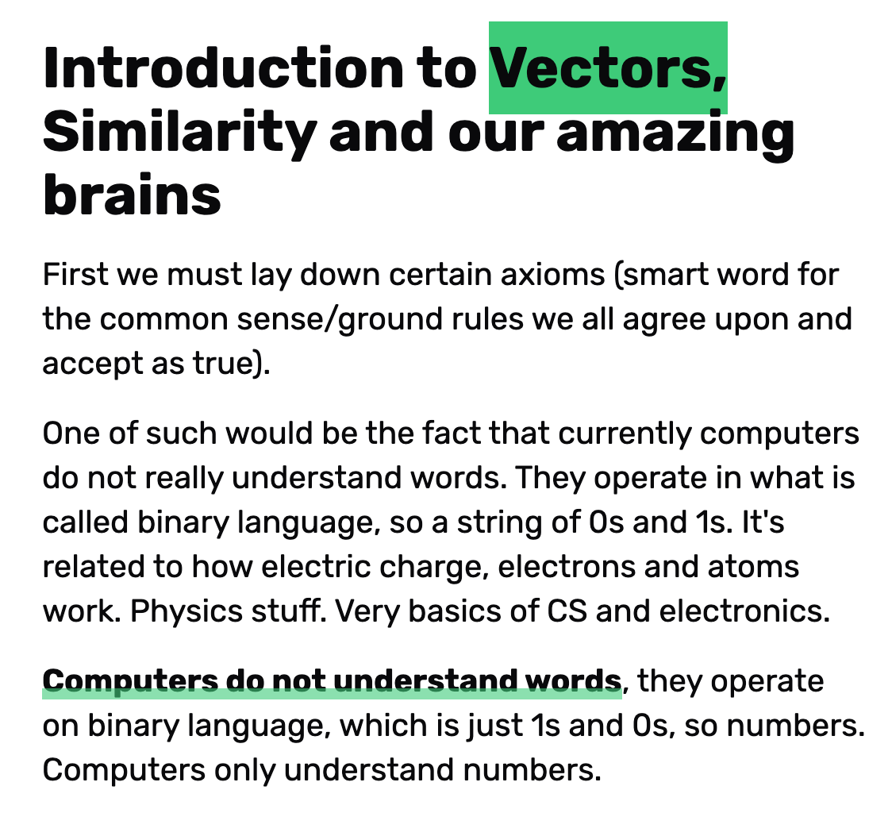
Introduction to Vectors, Similarity and our amazing brains

Slide 4
Computers do not understand words, they operate on binary language, which is just 1s and 0s, so numbers. Computers only understand numbers.

Slide 5
No words?
How to live with only numbers
Knowing that, it becomes obvious, that we may face some problems. First of all if it's all just 1 or 0, how do we express different numbers?
Well, that part is easy, because thanks to the decimal counting system.
Long story short, we have 10 digits to express stuff, in binary you have 2. That means that you still can represent other numbers with base 2, the resulting number will be just a bit longer and calculated differently. I won't to into too much of a detail here, you can look it up yourself -> binary system, decimal system and how to convert from one to another. Or ask chatgpt for an explanation.
It does a fine job. Just know that any natural number can be easily converted from base ten to binary e.g. "4" in decimal i s "100" in binary. They hold equivalent value, but are expressed differently. The case is a bit more complicated for floating point numbers, but let's not get into that now.

Slide 6
So first layer of abstraction is down.
We have computers. Electric. Electrons. High current/low current, current/no current. 1s and 0s.

Slide 7
These 1s and 0s of ours now can magically become numbers.
This is what our computers operate on - in every case.
When you dig deep enough, everything you interact with in the virtual world is in fact a number,
so a particular configuration of these tiny little something's in the computer that either have electricity
running through them, or they don't and that is interpreted as a number. Imagine 3 light bulbs.
1st is on, 2nd and 3rd are off. 1-0-0. We magically agreed that this means 4.
Now make the size smaller probably by a thousand, a milion times or something,
and you get an idea what's going on in that shiny macbook of yours. Back to the topic.
Numbers. Yes, we have them and are able to somehow interpret the current state of your computer, or it's part as it being a particular number.

Slide 8
Now that's not very useful, right?
We, humans, mostly operate on text and language, right? Yup.
Imagine a world where you have to decode numbers. in some magic dictionary to a word.
The computers wouldn't be so useful now, would they? But that's how it looks in the background.
Long time ago some smart dudes have gathered around that agreed that from now on, if we know we are dealing with text, we should interpret the number 65 as "A", "B" as 66 and so on.
Of course, it changed, different people had different standards and agreements but who cares, let's simplify. We come to understand the second axiom:

Slide 9
So the second layer of abstraction is down.
We, as society, have assigned certain roles/meaning to particular numbers, in this case it's letters.

Slide 10
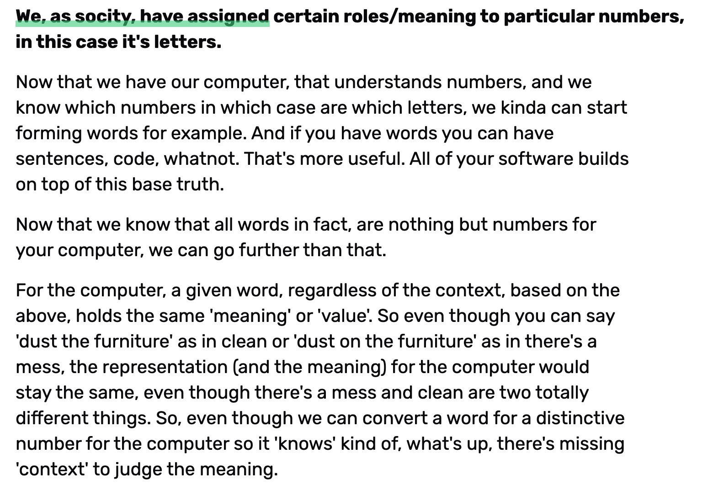

Slide 11
Words simply represented as binary numbers lack context.

Slide 12
Well, humans can be ingenious in the ways they do wicked things, but also in the ways the do great things. One such example here would be Contextualised word embeddings. What does that stand for? Well, let me tell you.

Slide 13
So we have this now simple case of turning a series of 1s and 0s into numbers, numbers into letters and then words.
That you already understood, right? We kinda explained the problem with that - lack of context. Well. We have developed methods that allow us to generate different and unique numbers for words, depending on their context or semantic meaning.
So if we used Contextualised Word Embeddings in our example above, the 'dust' from 'dust the furniture' would get totally different number than the word dust in 'dust on the floor'. Now the computer knows that these two have different meaning! How does that exactly work? It's a piece of work, let me tell you, but we won't cover that in this presentation.
First of all I'd have to understand that myself haha.

Slide 14
Long story short, we have a magic function that does this:
number_representation_of_a_word_and_meaning("dust", context="dust on the floor") == 42
number_representation_of_a_word_and_meaning("dust", context="dust the floor") == 24
The values are not random - words that within certain context have different meaning probably will have very different number assigned to them. A number that is far apart from the other one. If the meanings were similar, but just slightly different depending on the context, we'd have numbers that are closer to each other.

Slide 15
number_representation_of_a_word_and_meaning("bark", context="bark is a noun") == 12
number_representation_of_a_word_and_meaning("bark", context="bark is a verb") == 19
Why is that? "Bark" and "bark" both relate to something that is associated with outer protection or covering. If a dog barks usually it is a sign of danger, something related to safety, protection. The tree has a bark in order to protect itself from the environment. It's different, still, but this time we share a certain common theme at least in some sense, hence the numbers we got are closer together than in the previous case, because they are more similar.

Slide 16
Similar meaning of words, in a particular context, converted to numbers, are closer to each other than radically different meanings even if the words look the same.

Slide 17
By the way, what are embeddings you might wonder? Why did I not describe it earlier? Because we needed to understand the above to understand embeddings.
More or less it's what we described, so the way of representing a number based on particular set of criteria (in our case the semantic meaning) as similar numbers, even if they are not similar raw value wise.
So in the embeddings world, 'dust' would be, as a number, closer to 'clean' than 'dust' would be to 'dirt'. At least that's how I understand it. And 'dust' as in 'dust the floor' would be far away from both 'dust on the floor' or 'dirt'. Alright, this one was a bit trickier, but we got there eventually.

Slide 18
Again, let me reiterate.
We have electrons and then electricity.
Because of electricity (or to be more exact high/low current) we have 1s and 0s, so binary language.
Next are numbers, binary numbers, so just numbers but expressed only with 1s and 0s, base 2.
That gets converted to base 10, so the decimal system that we humans mostly use (not everywhere and not always lol - hi friends from India or the ancients). These numbers then get simply mapped to words with the same values regardless of the context, of the meaning, in the base case.

Slide 19
But nowadays, we iterated over that and can associate words with their meaning and assign different numbers, based on the context of the text or a sentence (sentence transformers sounds familiar?) and their semantic meaning.
The groundbreaking publication about Transformer model. Go look it up.
By the way look at the year it was published and how quickly we went from theoretical stuff to something as amazing as GPT-4. INSANE. Either way.
Semantic meaning, embeddings and transformer model. This is the reason that the LLMs or generative AI can sound so convincing, as if it really knew the stuff it generated. Nope, it doesn't. It just processes numbers, they do not intrinsically understand the meaning, they understand that 1 is closer to 2 than 24 is to 42, which is the answer to everything.
See what I did there? This does not imply it 'understands' the meaning in the human sense and why I'm quite sure that AGI (Artificial General Intelligence), so something that 'really' thinks in the most human way, is so far away. The current technology and models, simply do not work like we assume them to.

Slide 20
Okay champ. We have these words mapped to different numbers, which are either closer or further away, depending on the semantic meaning in a particular context. What now?

Slide 21
Well, math magic comes in. I ain't no maths guy, I do enjoy the thought exercises or elementary and truthfully representation of stuff it can provide, nowadays I'd struggle to solve quadratic equation probably, being just a simple highschool dropout, but let me share with you my understanding of this absolutely marvellous phenomenon that happens.

Slide 22
So, numbers. In maths we have this thing called Algebra.
It's a study of relationships between things that vary over time, which are represented by symbols, usually letters, which also can represent things, usually numbers. What? ... Yeah. That would be my reaction to this statement too, at least was in the past.
Let's make it a bit more digestible. To put it in simple terms, for us numbers are things that allow us to measure reality, count things, they are building blocks of reality you could say. Almost everything (or as some would argue - everything), given a proper formula, could be represented as a number.
Be it something so physical as the length of your arm, number of apples in your kitchen or something as abstract as human language or even the meaning of a word, which we have demonstrated above.
That however relates to this particular branch of mathemathics and 'real' stuff. In here numbers are immanent, simple, natural, the best. What about branches of maths that operate on a bit different set of rules and so on? Different universes of sorts? Well, in there numbers might not be the best base unit of operation, in different universes we might need either different base building blocks or we might want to take numbers and extend them a bit, if you will, to make life easier.

Slide 23
One such example is the study of Linear Algebra. Linear Algebra has 'vectors' (which in fact are numbers with certain additional stuff to abstract ideas and make life easier) the same way basic Algebra has numbers/symbols/variables. I won't go into the details here too much as my understanding is also not so perfect, and probably I'd spout some gibberish, but I hope you get the analogy.

Slide 24
Space can have many 'dimensions', similarly with vectors. If you have one dimension, it's just [1].
If we have two, e.g. X & Y axis, we can position a point in place by having, well, two numbers for each dimension, eg [1,1], this should ring a bell if you remember anything from your middle school math class. What if we have 3D space? Well, similar stuff.
Notice how each additional dimension multiplies the number of all the possible vectors.
So let's assume we are working on a limited range of natural numbers, 1 to 10. In 1D case, we have 10 options. In 2D space we have 10 possibilities for first one, 10 for the second one, which totals to 10 * 10 = 100 possible different combinations. In case of 3d? You get the idea.

Slide 25
So now imagine how insanely big the possibilities are, if we are working with a bit of a broader range (e.g. 65536 or 256) and not with 3 dimensions, but with 1536! That's INSANE. Absolutely insane, but also what allows our LLMs to seemingly perceive so many nuances in the meanings of the words and what nots.

Slide 26
I know it was a long digression, but bear with me. Again.
We have electrons and then electricity. Yeah, I'll spare you that repetition again. Number representation of a word based on semantic meaning. So we have a number per meaning in a given context let's say.
This number gets then turned into a vector which lives inside vector space. To accommodate for the many meanings and contexts and how contextual our actions, words and speech are, this vector space should have appropriate number of dimensions, each dimension related to different part of true meaning/context.
It can't have too much as it'd get too huge to process. OpenAI settled for 1536 dimensions. Remember each 'dimension' can be assigned a different 'value', so the total number of possible meanings is THE_MAX_NUMBER_WE_OPERATE_ON to the power of 1536. THAT"S A LOT. Anyhow.

Slide 27
We went from having 1s and 0s, to our words being evaluated in 1536 dimensions or 'meanings'. The more true to a particular meaning is that word, the higher the value it'll get in that dimension.

Slide 28
As you can see we have a problem now. How do we actually process such a humongous amount of data? Traditional methods don't really work well or would be too expensive computationally or economically.
This is what we call "curse of dimensionality". To deal with this, stuff like Approximate Nearest Neighbour Search problem show up. Meaning: how do we find similar vectors (numbers) in very high dimensional spaces?

Slide 29
To resolve that puzzle we came up with Hierarchical Navigable Small World or HNSW. What is that? Long story short, even though the space is so HUGE, usually, in large networks, eg. human ones or social ones, despite the size, most nodes can be reached from any place in the network with surprisingly few steps. It's often reffered to as "six phones rule", that states that you are at maximum six phone call aways from anyone in the world.
For most people it’s within 2-4 range.
Imagine this, you potentially are 2-6 phone calls away from Donald Knuth.

Slide 30
You know someone who knows someone and so on, then boom. Your message gets delivered to Obama. It's quite interesting actually. Important to note is that not all nodes in the network are connected equally. There are these things called as hyperconnectors (there’s cool research/book about it recommended), which connect to A LOT of nodes, and the contrary so, the nodes that are a bit lonely. I think you get the idea and seen an example in your life - almost everybody knows that someone who seems to know everybody everywhere.

Slide 31
Either way, as I digress. If we take this Small World thing and add one more thing on top of it - hierarchy, managing even such a huge amount of data becomes doable. What does it look like? Simple.

Slide 32
Think in terms of enterprise org chart. It's as if, let's say, you were a CEO and wanted to know something about if your company does use type hinting in python like human beings do.

Slide 33
In HNSW the approach would be to first select a candidate, who might know something (be similar to the topic/value you search for) from a very few selected people in the company (mby the hyperconnectors should be at the top? ;)).
Let's say the are Lead/Director level people. So you e.g. have Director of PeopleOPs, Director of Product, Director of Engineering and so on.
Out of these, the semantic value of Director of Engineering will be most similar to "do we use type hinting in python". So we go to him and there we repeat the process.
However our guys here are lazy for whatever reason. He doesn't want to check or write the answer, so he delegates. -> who does the director know, who in the hierarchy is the level below him (these are the guys he knows best, he doesn't know the ones lower too well as he doesn't interact with them often) that should know the answer?
So he repeats the process: Engineering Manager in Frontend team, EM in DevOps, EM in Backend team. Backend Team it is.

Slide 34
Now this process gets repeated till we hit the bottom most layer of hierarchy, how many there are is up to the organisation to decide.

Slide 35
This way instead of the CEO asking maximum number of N people in the worst case, assuming that only the last person knew, the question gets asked only M maximum number of times, where M is the number of layers in the hierarchy we have. Or something like that.

Slide 36
Of course if he asked the question to everyone he would have better data and could select the best answer.
The one he will get in the case of using HNSW will be good enough (how good we want will require us to define a certain metric, but the more accurate the answer needs to be, the tricker it is computationally) but will cost SIGNIFICANTLY less to get.
Think sth like rolling out a feature that covers 80% of the needs in 2 weeks vs perfecting it to 99.99% in 2 years. 80% (or 50 or 95) is usually good enough when you weight the pros and cons, cost/benefit.

Slide 37
WOAH. Long story long, this is what enables us to process such huge amounts of data that is so high in dimensionality, that can accommodate the various context, nuances and meanings that is associated with for example human speech or thinking process.

Slide 38
Now imagine our brains do this at a higher and more profund level than this, they do it constantly, all the time, they fit into something small like our skull and run on the equivalent of 24 Watts of power per hour. In comparison GPT-4 hardware requires SWATHES of data-centre space and an estimated 7.5 MW per hour. So around 312 500x less while doing stuff that is thousand times more sophisticated. WHAT THE.
We are a wonder of Nature. An amazing mess of a wonder but a wonder nonetheless. Also, keep in mind that our brains don't dedicate 100% of the horsepower to conscious thinking processes.
According to Auburn University paper I found, cognitive neuroscientists believe that only 5% of our cognitive activity is conscious. So multiply this number by anything from 20 to a 100.
Let's be conservative and say 10 for some reason. That's still over 3 million times the efficiency than GPT-4, while also having at least a magnitude (or at least N) greater complexity of processes to handle. I got carried away in the amazement.

Slide 39
TLDR: Electrons -> Electricity -> Binary -> Binary Numbers -> "Human" or base 10 numbers -> Letters -> Words -> Embeddings -> (Semantically) Contextual Word Embeddings -> Algebra -> Linear Algebra -> Vectors -> Vector Spaces -> High Dimension Vector Spaces -> Approximate Nearest Neighbour Search or just Nearest Neighbour Search (ANNS/NNS) -> Hierarchical Navigable Small World (HNSW)

Slide 40
Soak up all these terms and write them down. From here we are almost done. If you've been following closely you might start to piece the puzzles together.
LLMs are in fact just algorithms, very complex ones, that have indexed or ingested A LOT of data/words, vectorised and embedded them and their meanings in particular context. You can think of it as a VERY highly compressed library in fact.
Then, based on that data, they just 'guess', based on context, that if we have this particular thing or meaning in a semantic context, so embeddings, so numbers or vectors in high dimensional space, just right here, we probably have in mind this particular response which is nothing but a set of other embeddings.
So for 1 + 1 the answer is probably “= 2”, but can be “= 4” if the training data is bad or something. For LLM, even tho the answer is wrong, it’s equally right.
Have in mind tho, they do not understand that all. They just guess. LLMs are nothing more than stochastic parrots.
So, NO, LLMs do not “think”. Regardless of whatever someone tells you. It’s all just probabilistic entropy.

Slide 41
Speaking of let’s touch up on the ‘hallucinations’.
Answers from LLMs that are totally wrong are usually termed hallucinations - LLMs writing out things that are not true.
The problem with that is, well, to an LLM, they are, in fact no different from the the proper responses.
Does it mean that from LLM perspective all text they generate are hallucinations? Both yes and no, it’s a bit more complicated here.
Also if it’s all about probability and randomness, you now kind of know why it’s hard to get deterministic outputs for LLMs. It’s just not in their nature, however with certain steps you can almost get there, almost.

Slide 42
So if based on the context and approximation, we know that this particular query seems like something that will be associated with this particular token, we will use it. Then if we have one token ahead, we can repeat the process till we start hitting lower levels of association, which in turn means that we can probably stop generating as the answer is complete.
So... Yup. There's no thinking happening. Just assosciating numbers and guessing. You read that right. GPT-4 does not 'think' at all. It's as far away from human consciousness as we are from Putin being a good guy. This simply does not come even close. So it's the reason I do not worry at night (at least yet) AGI will come and replace me or go on a conscious crusade against humanity.

Slide 43
Bear in mind, my understanding of the stuff is VERY limited, I'm all new to this.
I've simplified A LOT not only for the reader, but also for myself. If any of this is unjustly inaccurate, let me know. I've googled most of the stuff along the way back. WHOAH. DAMN THAT WAS LONG.
Let's answer the initial question then. How do vector databases work then? Well, they take the text. Vectorise it. Embed them in high-dimension space, then if you query it, they search for approximate similar tokens/pieces/texts. Simple, right?
Now with that over, let's get to the stuff I had in mind when starting the article, so comparison of vector databases and a raport from using some of the more popular ones.

Slide 44
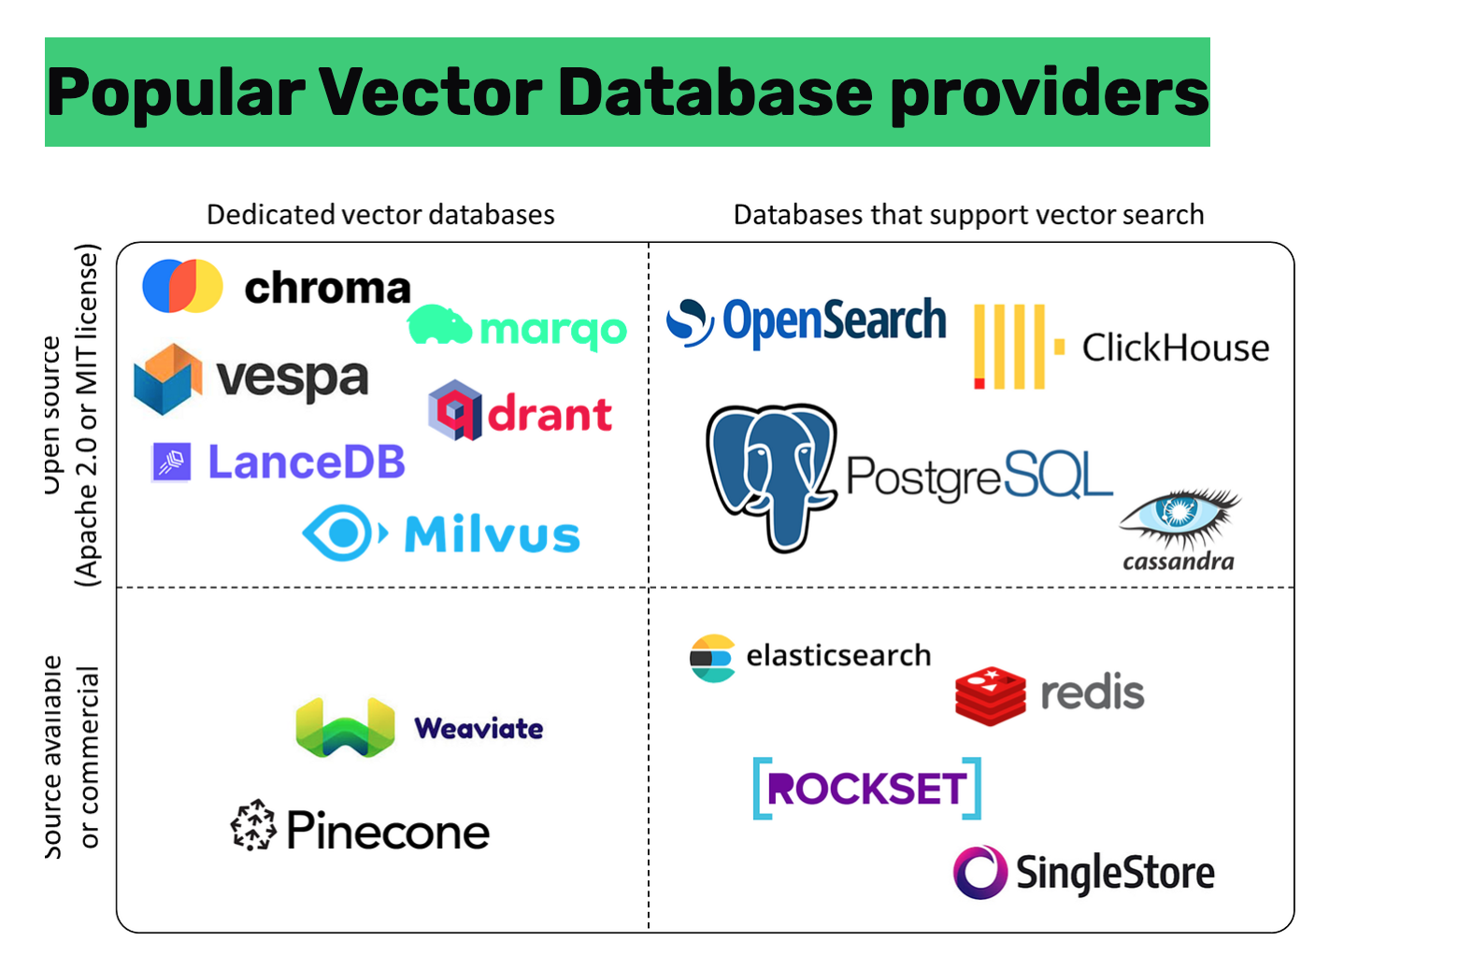

Slide 45
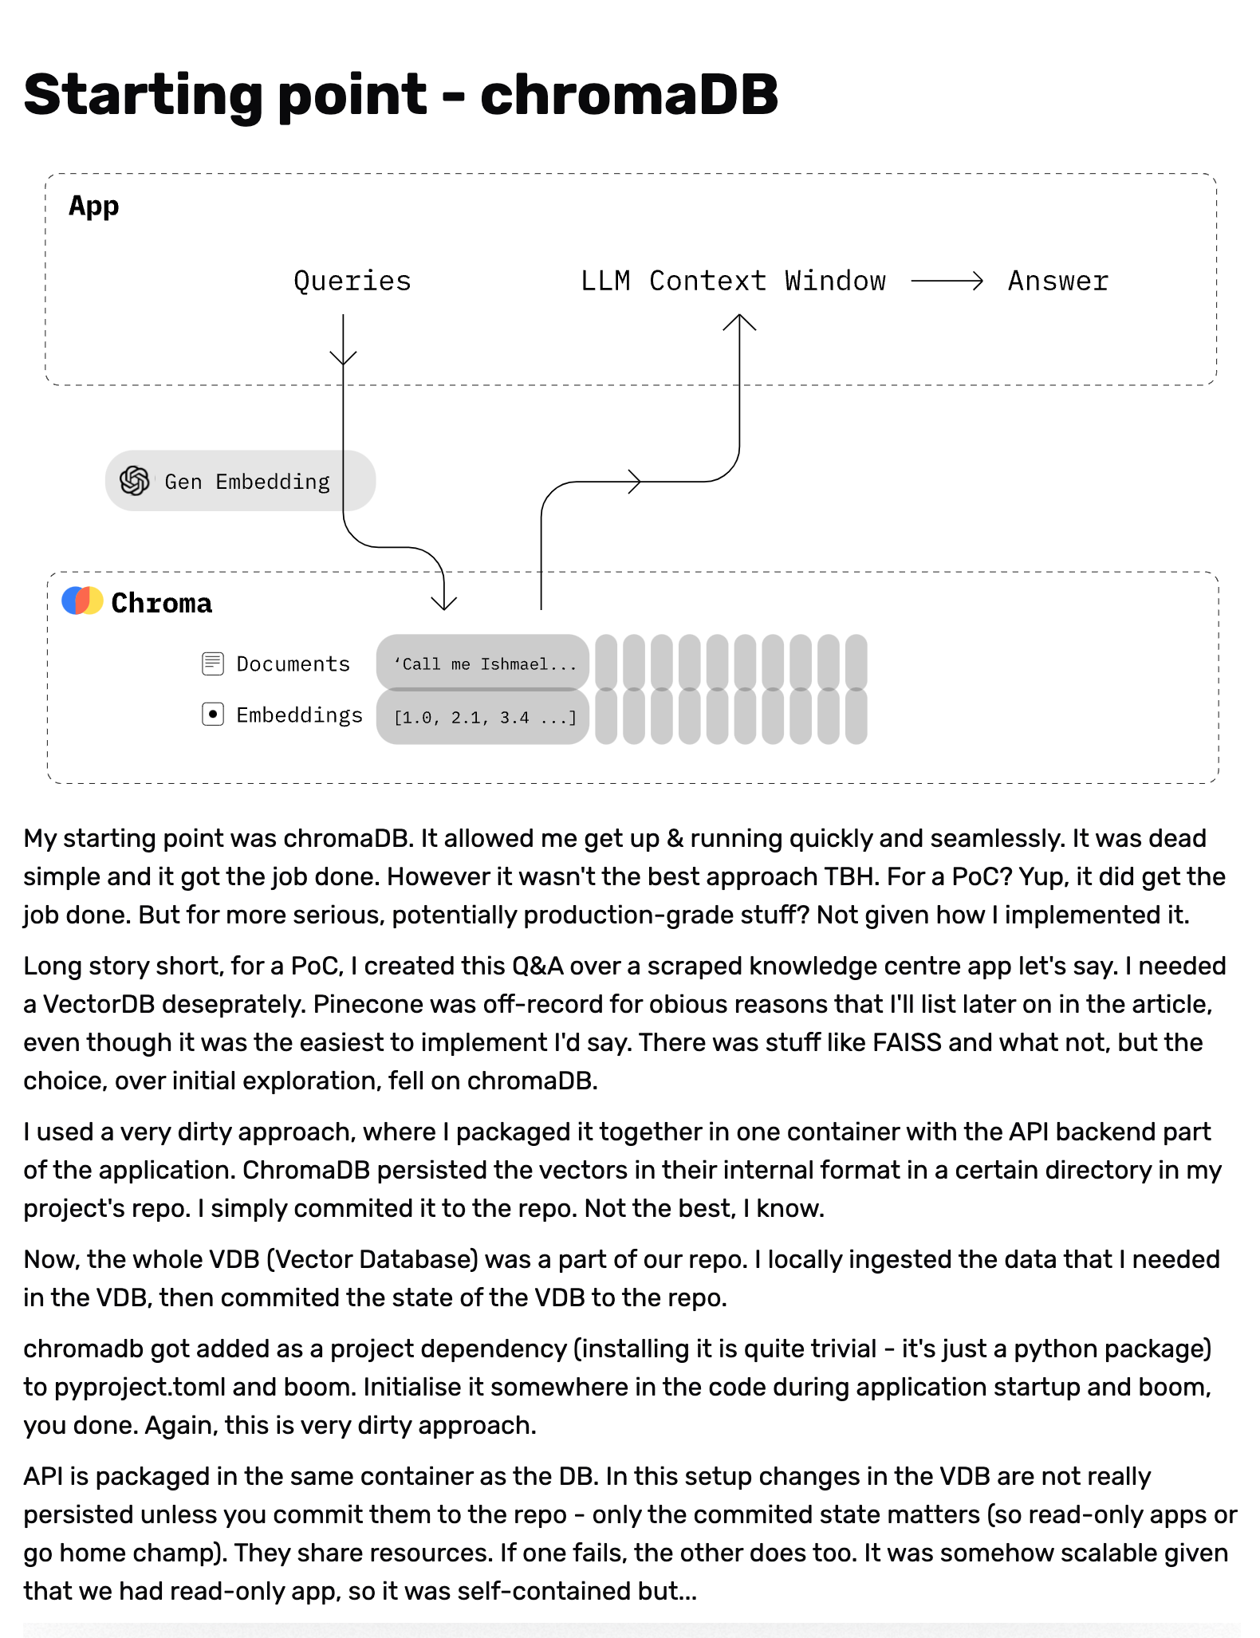

Slide 46
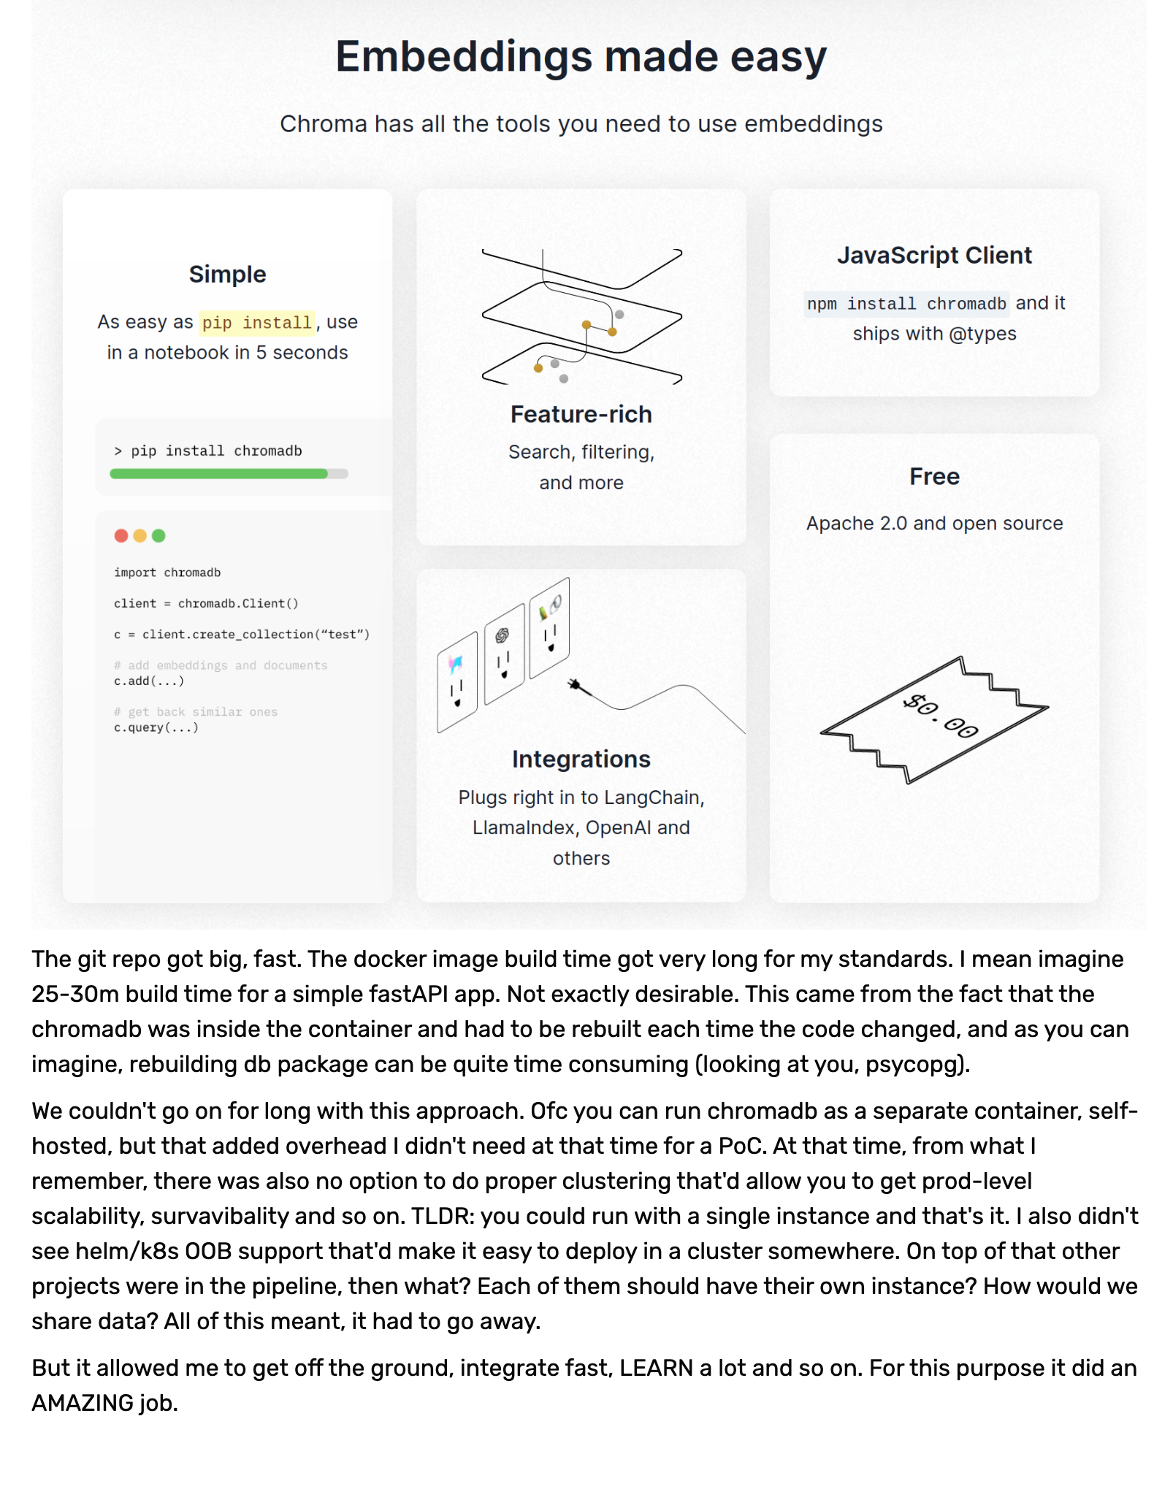
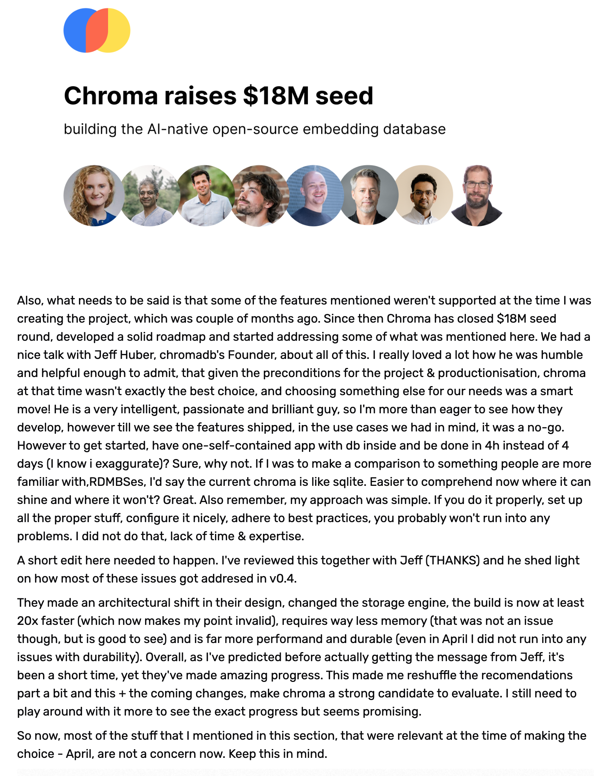

Slide 47
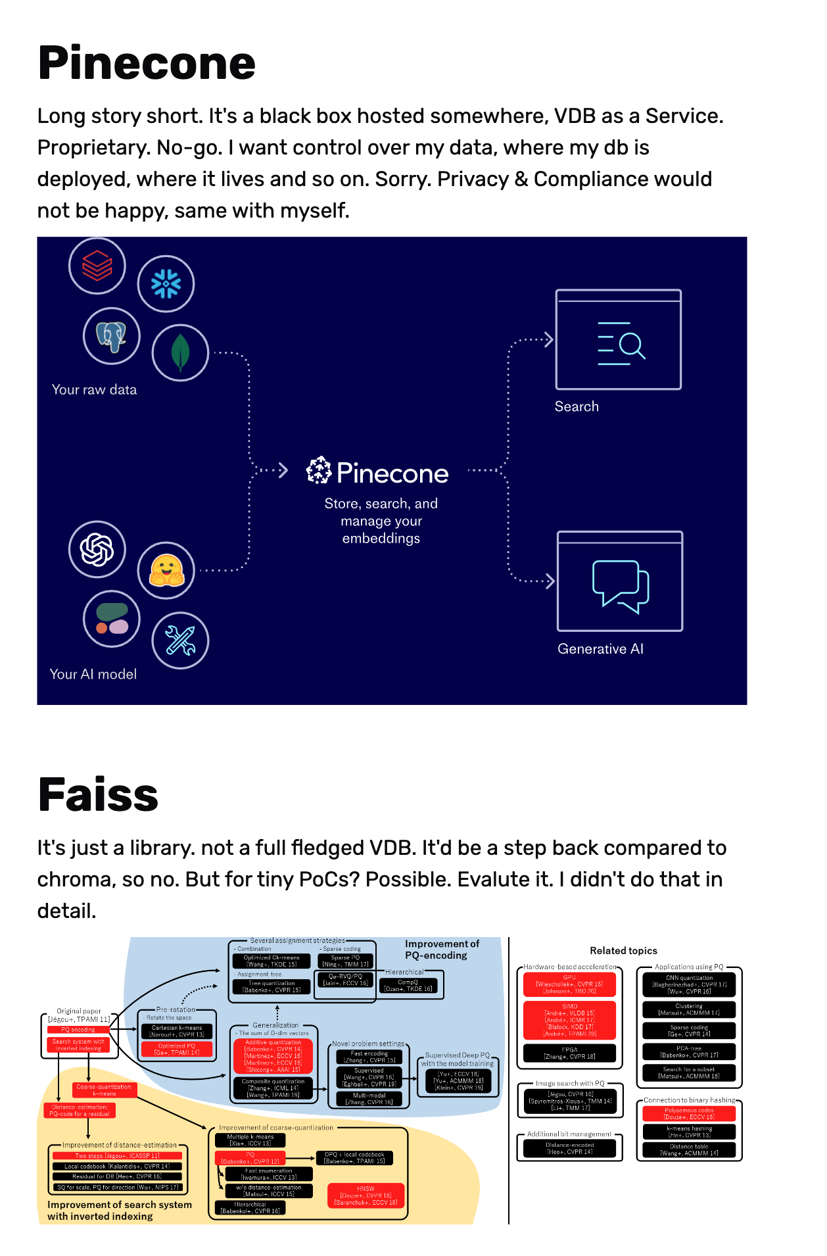
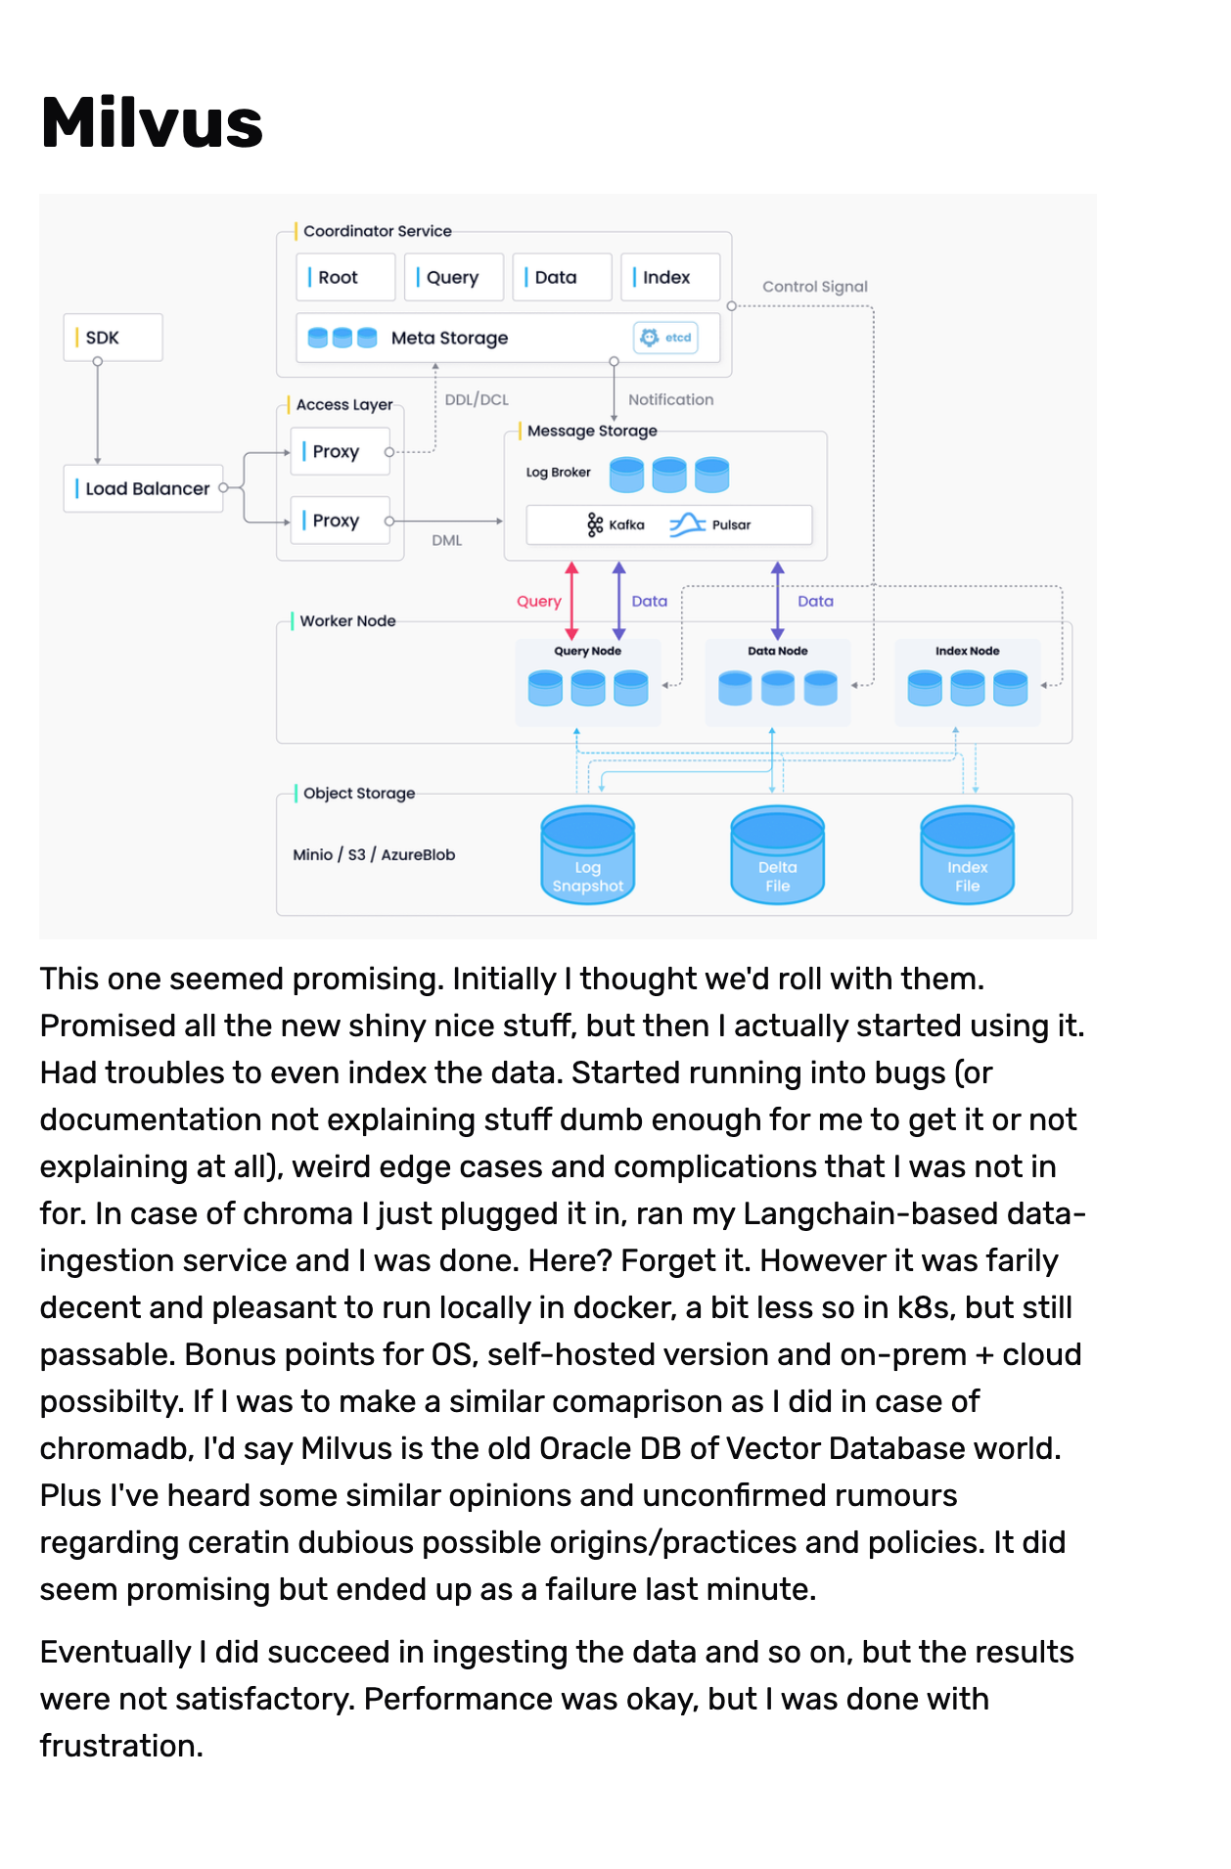

Slide 48
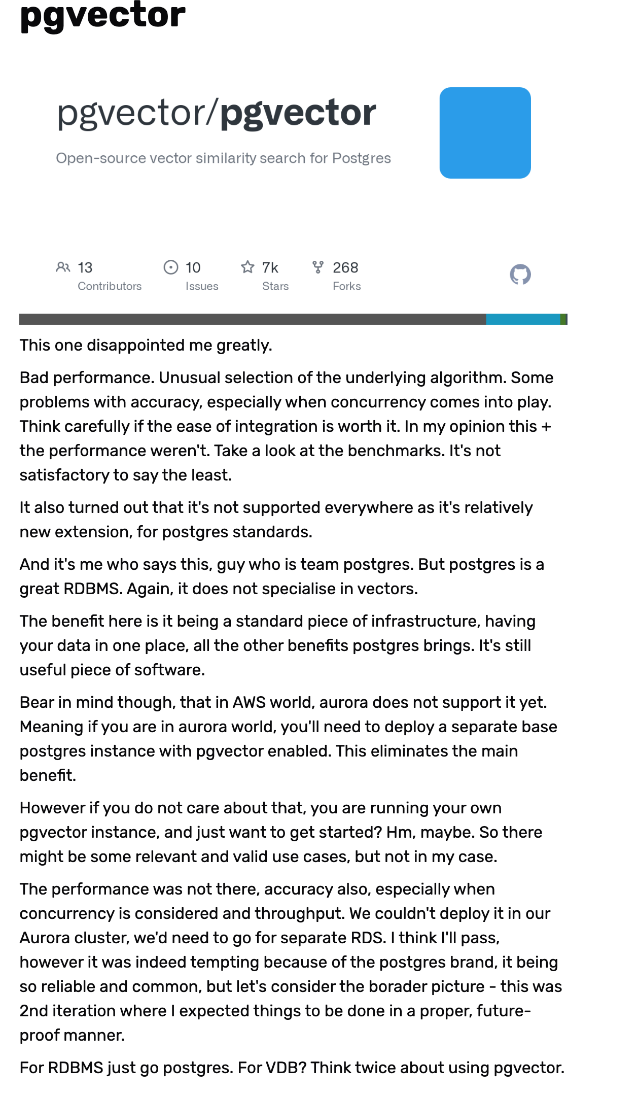
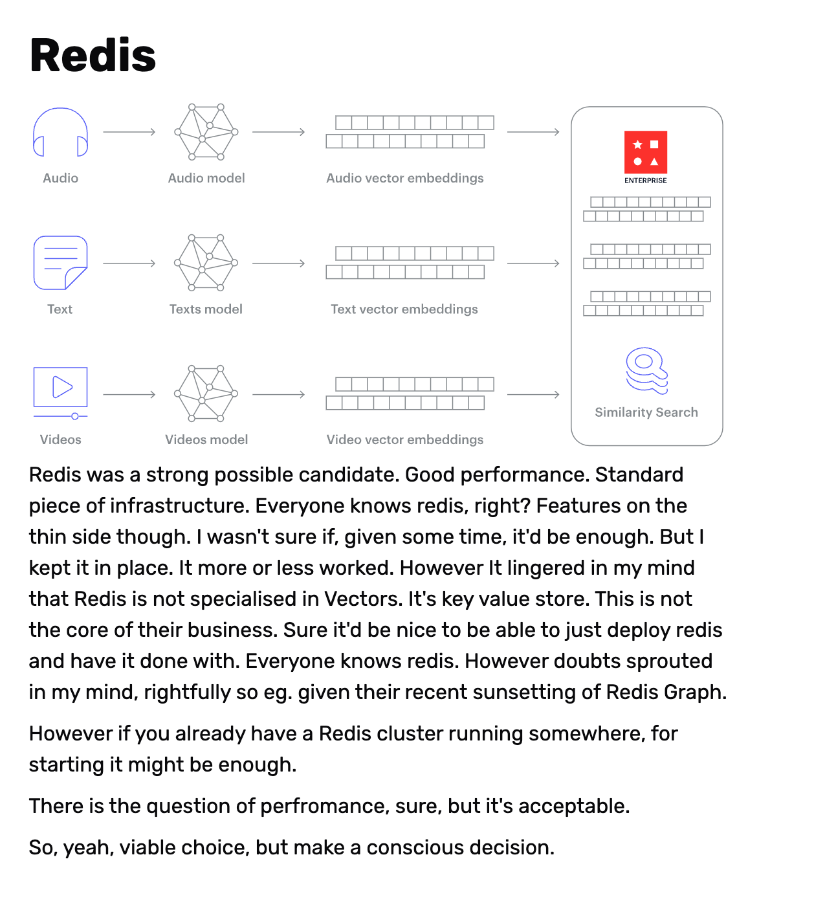

Slide 49
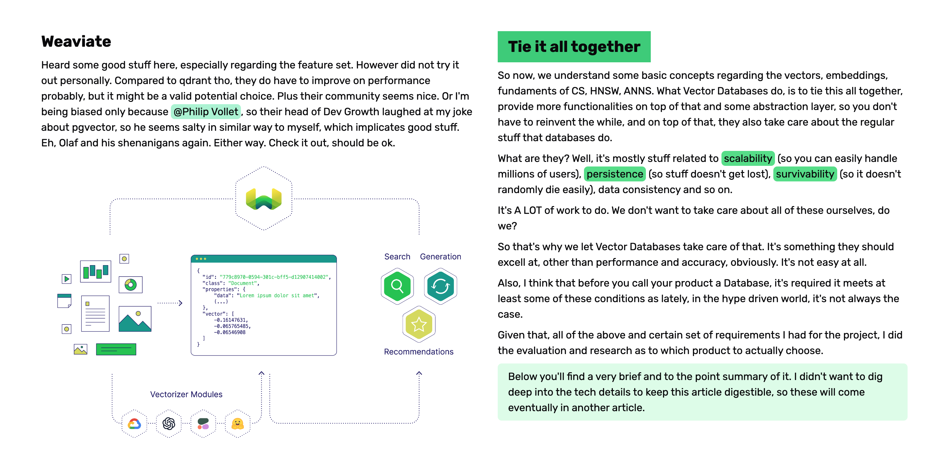

Slide 50
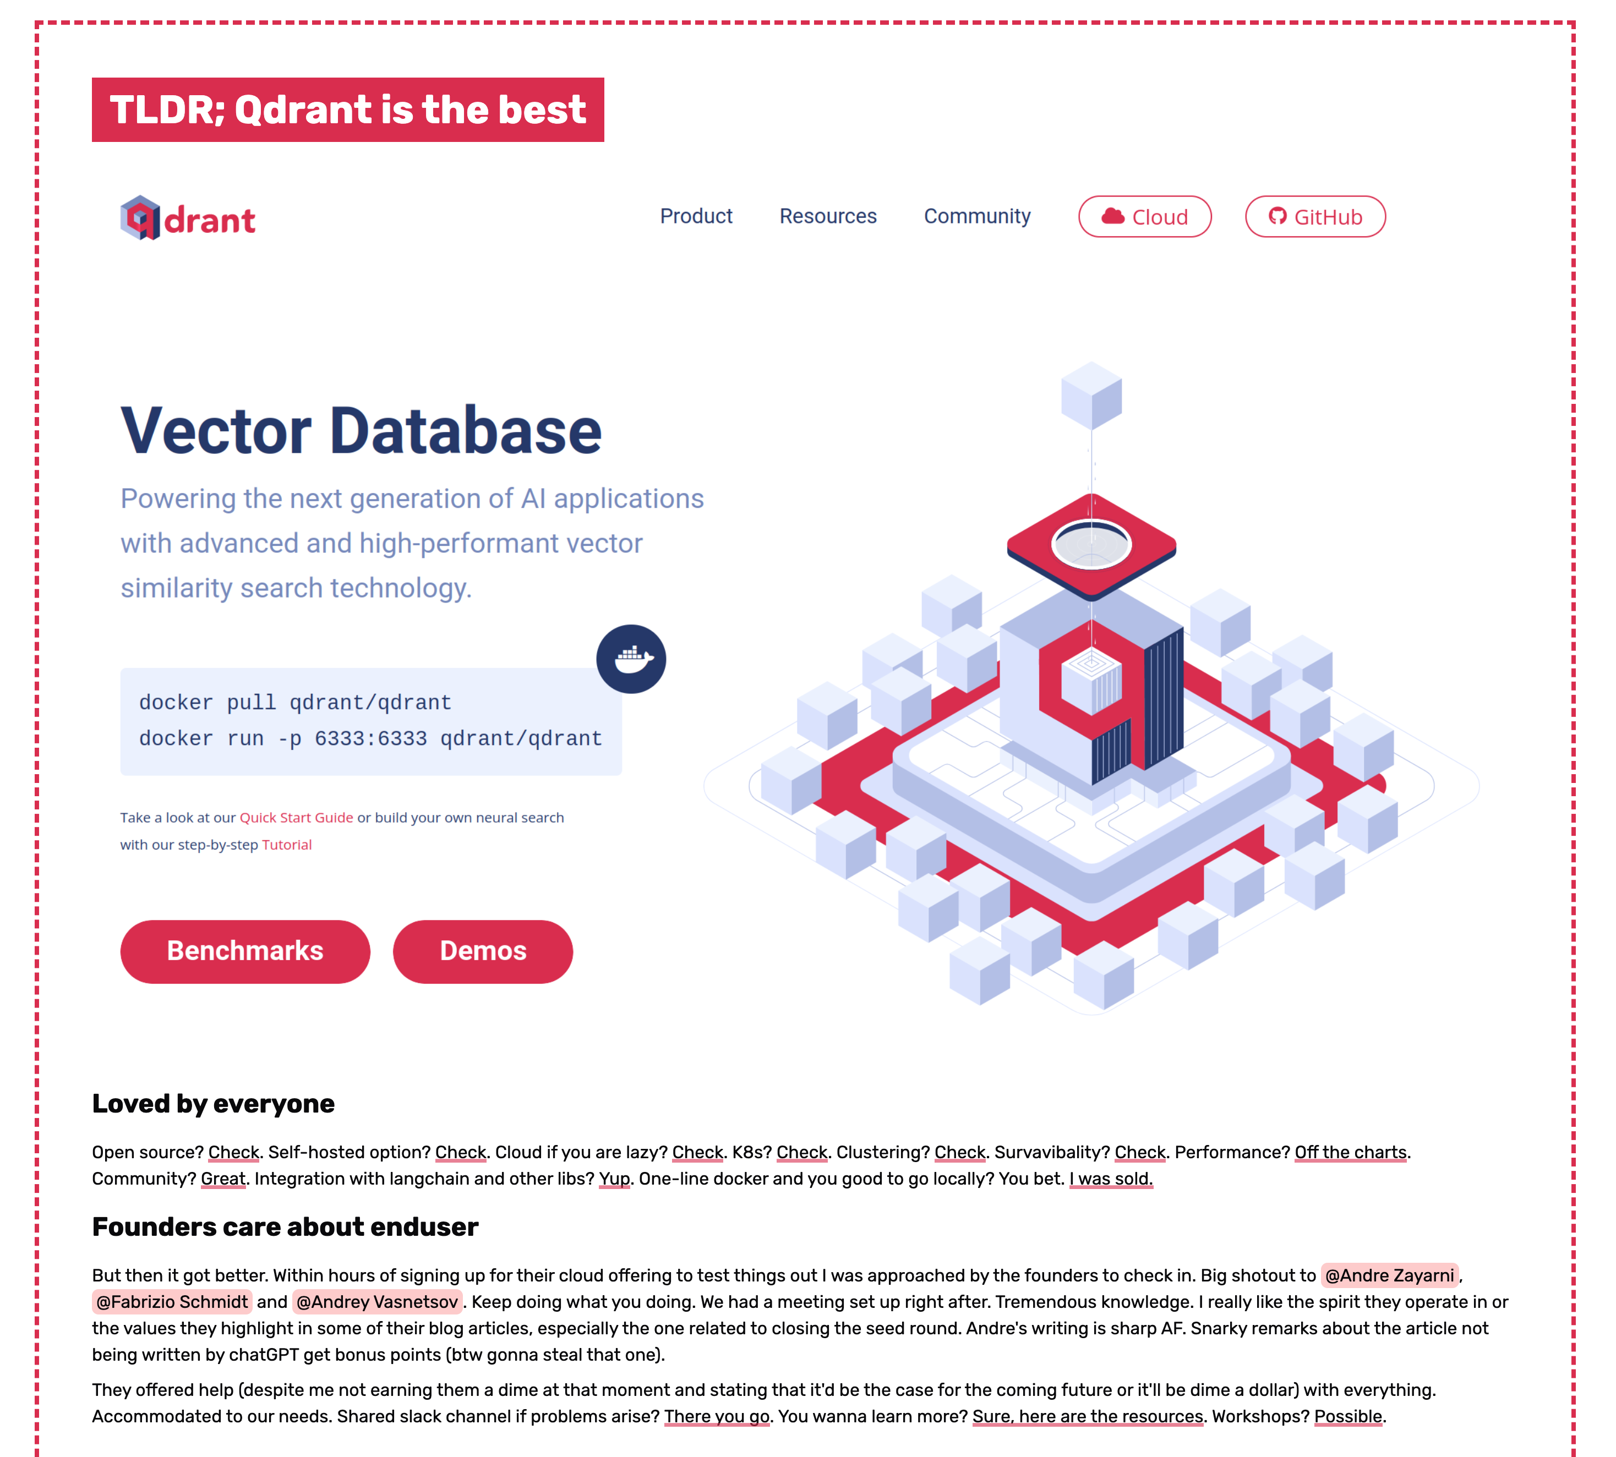

Slide 51
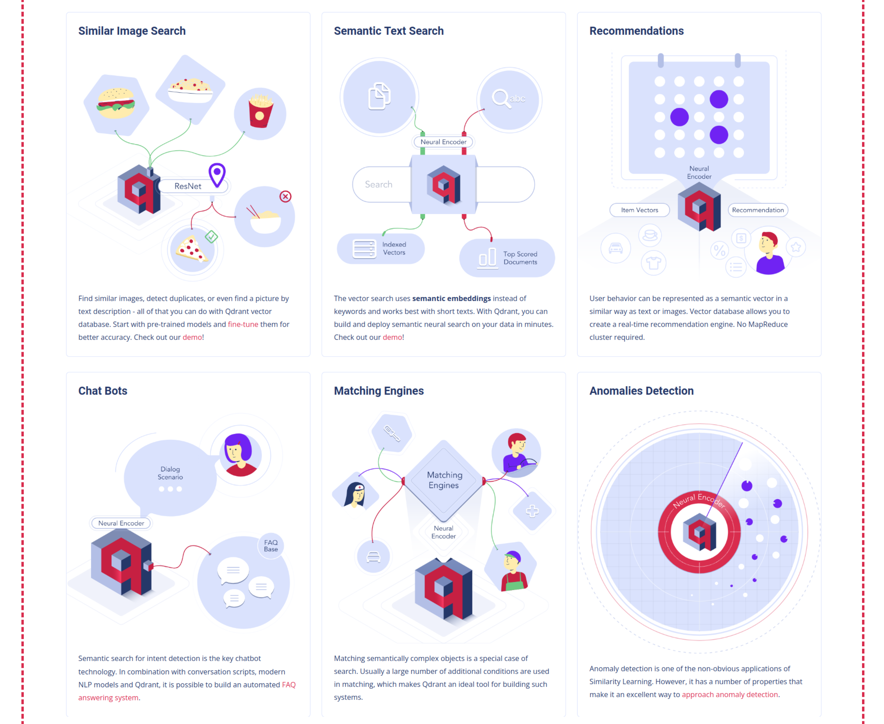

Slide 52
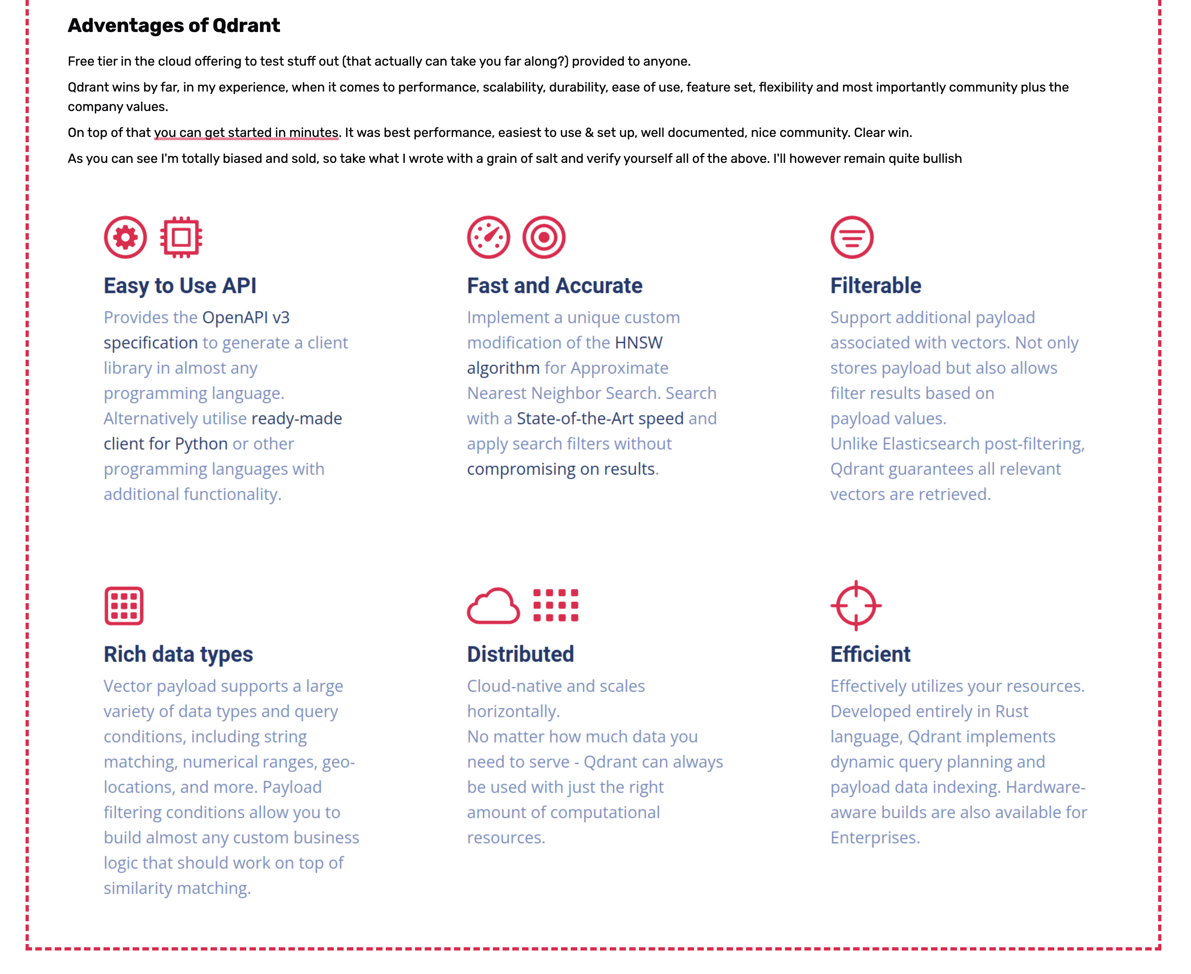

Slide 53
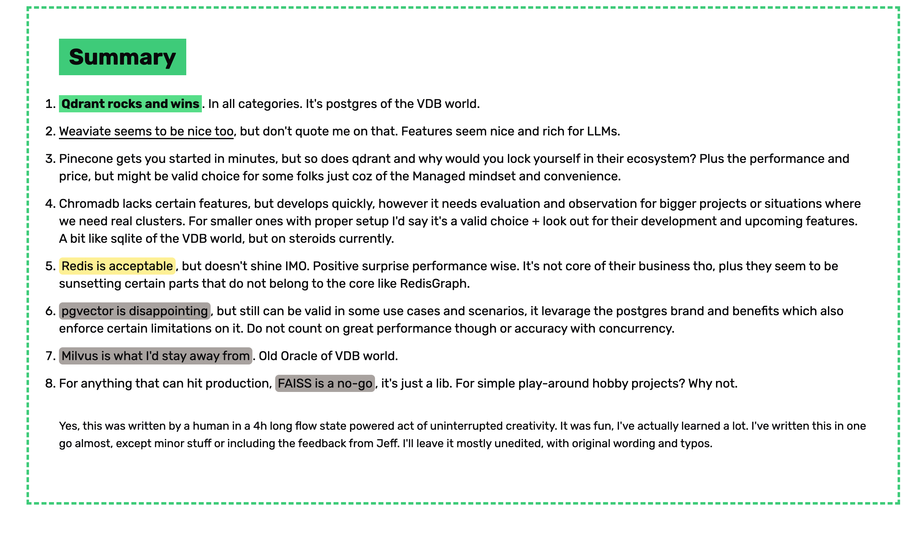

Slide 54
TLDR of TLDR:
For bigger data, scalability and performance go for qdrant/weaviate.
In some cases you can get away with using FAISS/chromadb and it will still do a good job.
If you want to experiment you can implement your very own VDB for simple purposes (or use e.g. ready made from pip - vectordb looking at ya)
https://github.com/jina-ai/vectordb
https://www.linkedin.com/pulse/vector-databases-demystified-part-2-building-your-own-adie-kaye/
https://medium.com/@saptarshichaudhuri/implementing-a-simple-vector-store-and-retrieval-functionality-using-python-f868bb9fff06
https://medium.com/@vidiptvashist/building-a-vector-database-from-scratch-in-python-6bd683ba5171

Slide 55
Lastly, recently some of friends of mine released this handy comparison:
https://superlinked.com/vector-db-comparison

Slide 56
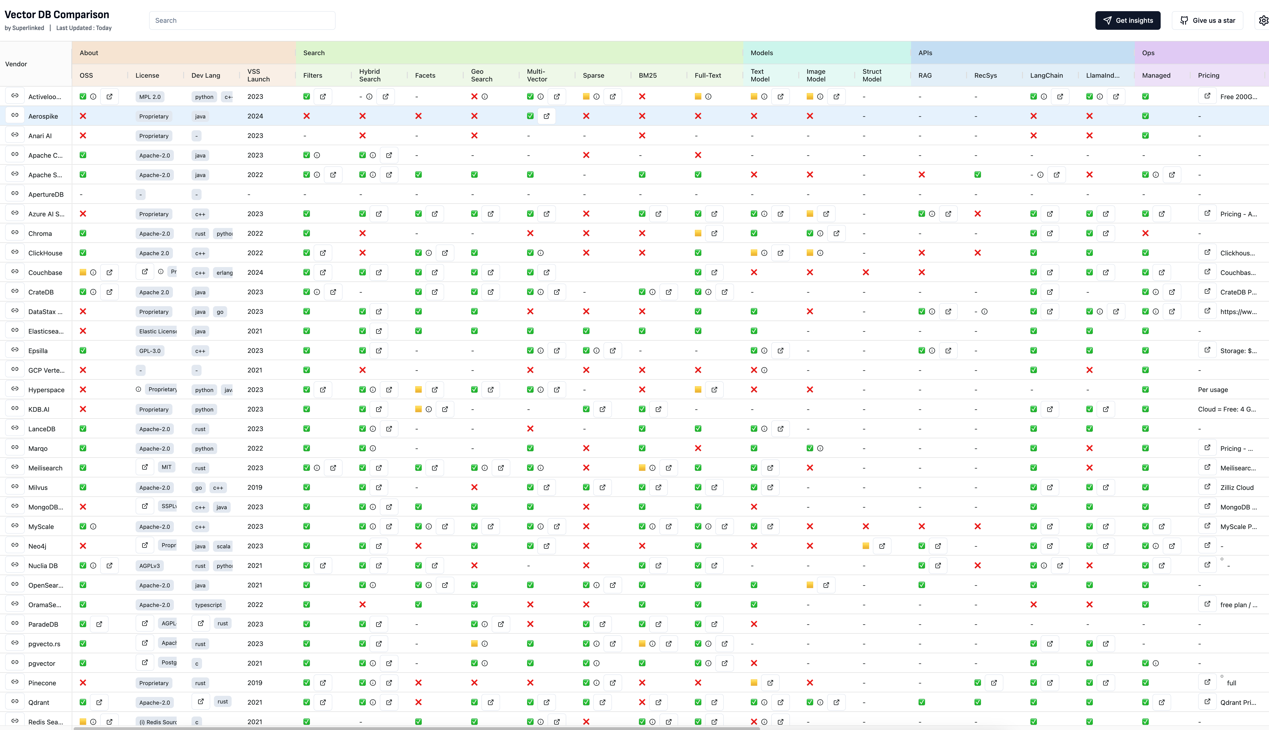

Slide 57
And with that, finally, DONE!

